Slide 1
The Ankle
38 CFR codes 4.40, 4.45, 4.59, 4.71
DC 5270-5274
Temp 100
Notes:
Today we are talking about the ankle. Going over list.

Slide 2
Overview of primary 38 CFR codes applicable to ankles
§ 4.40
§ 4.45
§ 4.59
§ 4.71
Notes:
These are the codes we’ll be looking at on the next few slides to help define what kinds of things “make” an ankle condition. These codes apply to more than just the ankle, they are applicable to any joint, but we’ll be focusing only on the information that pertains to the ankle.

Slide 3
Defining Ankylosis
Ankylosis is a stiffness of a joint due to abnormal adhesion and rigidity of the bones of the joint, which may be the result of injury or disease.
The rigidity may be complete or partial and may be due to inflammation of the tendinous or muscular structures outside the joint or of the tissues of the joint itself.
When the structures outside the joint are affected, the term "false ankylosis" has been used in contradistinction to "true ankylosis", in which the disease is within the joint. When inflammation has caused the joint-ends of the bones to be fused together, the ankylosis is termed osseous or complete and is an instance of synostosis.
Notes:
Definition from the encyclopedia Britannica. Basically reading this slide

Slide 4
§ 4.40 Functional loss
Disability of the musculoskeletal system is primarily the inability, due to damage or infection in parts of the system, to perform the normal working movements of the body with normal excursion, strength, speed, coordination and endurance. It is essential that the examination on which ratings are based adequately portray the anatomical damage, and the functional loss, with respect to all these elements.
The functional loss may be due to absence of part, or all, of the necessary bones, joints and muscles, or associated structures, or to deformity, adhesions, defective innervation, or other pathology, or it may be due to pain, supported by adequate pathology and evidenced by the visible behavior of the claimant undertaking the motion.
Weakness is as important as limitation of motion, and a part which becomes painful on use must be regarded as seriously disabled. A little used part of the musculoskeletal system may be expected to show evidence of disuse, either through atrophy, the condition of the skin, absence of normal callosity or the like.
Notes:
38CFR Code 4.40 is Functional Loss. Functional loss is the inability of the ankle to perform “normal” working movements of the body. I.E. excursion, coordination, range of motion. The wording specifies that the doctor will need to do a thorough examination recording what the veteran’s ankle is able to do compared to all the listed “normal” movements. There are multiple options for what leads to functional loss. An example for the ankle specifically would be bone adhesions or torn ligaments. The most important factor of functional loss is that it’s the claimant being unable to undertake the motion. Whether or not the doctor is able to manually manipulate the ankle in the correct fashions does not rule out functional loss. Another important factor to note is weakness. That can be an indication of functional loss in addition to or in place of the limitation of motion. If the veteran is not using the ankle at all (i.e. they are in a wheelchair), then there needs to be evidence of that disuse, either through atrophy, the condition of the skin, absence of normal callosity or the like.

Slide 5
§ 4.45 The joints
Less movement than normal (due to ankylosis, limitation or blocking, adhesions, tendon-tie-up, contracted scars, etc.).
More movement than normal (from flail joint, resections, nonunion of fracture, relaxation of ligaments, etc.).
Weakened movement (due to muscle injury, disease or injury of peripheral nerves, divided or lengthened tendons, etc.).
Excess fatigability.
Incoordination, impaired ability to execute skilled movements smoothly.
Pain on movement, swelling, deformity or atrophy of disuse. Instability of station, disturbance of locomotion, interference with sitting, standing and weight-bearing are related considerations.
For the purpose of rating disability from arthritis, the shoulder, elbow, wrist, hip, knee, and ankle are considered major joints; multiple involvements of the interphalangeal, metacarpal and carpal joints of the upper extremities, the interphalangeal, metatarsal and tarsal joints of the lower extremities, the cervical vertebrae, the dorsal vertebrae, and the lumbar vertebrae, are considered groups of minor joints, ratable on a parity with major joints. The lumbosacral articulation and both sacroiliac joints are considered to be a group of minor joints, ratable on disturbance of lumbar spine functions.
Notes:
This defines major and minor joints and then mentions the different ways a joint can be considered disabled.

Slide 6
§ 4.59 Painful motion
With any form of arthritis, painful motion is an important factor of disability, the facial expression, wincing, etc., on pressure or manipulation, should be carefully noted and definitely related to affected joints. Muscle spasm will greatly assist the identification. Sciatic neuritis is not uncommonly caused by arthritis of the spine. The intent of the schedule is to recognize painful motion with joint or periarticular pathology as productive of disability. It is the intention to recognize actually painful, unstable, or malaligned joints, due to healed injury, as entitled to at least the minimum compensable rating for the joint. Crepitation either in the soft tissues such as the tendons or ligaments, or crepitation within the joint structures should be noted carefully as points of contact which are diseased. Flexion elicits such manifestations. The joints involved should be tested for pain on both active and passive motion, in weight-bearing and nonweight-bearing and, if possible, with the range of the opposite undamaged joint.
Notes:
Painful movement is kind of the opposite of Functional loss. The claimant more than likely can move their ankle on their own, but it causes them pain or distress usually noted with facial expressions, wincing, etc. Another common identifier is muscle spasms. Followed by crepitation. Who remembers what crepitation means?
One major difference, is that painful motion can be detected either when the claimant tries to use their ankle, or when someone else is manual manipulating it. The examiner should test the ankle for pain both with active and passive motion, in weight and non weight bearing, and if possible, with the range of the other ankle.

Slide 7
§ 4.71 Measurement of ankylosis and joint motion.
Plates I and II provide a standardized description of ankylosis and joint motion measurement. The anatomical position is considered as 0°, with two major exceptions: (a) Shoulder rotation - arm abducted to 90°, elbow flexed to 90° with the position of the forearm reflecting the midpoint 0° between internal and external rotation of the shoulder; and (b) supination and pronation - the arm next to the body, elbow flexed to 90°, and the forearm in midposition 0° between supination and pronation. Motion of the thumb and fingers should be described by appropriate reference to the joints (See Plate III) whose movement is limited, with a statement as to how near, in centimeters, the tip of the thumb can approximate the fingers, or how near the tips of the fingers can approximate the proximal transverse crease of palm.
Notes:
So 38CFR code 4.71 talks about the plates that show the “normal” range of motion standards. There isn’t a lot in the code itself that applies to ankles.

Slide 8
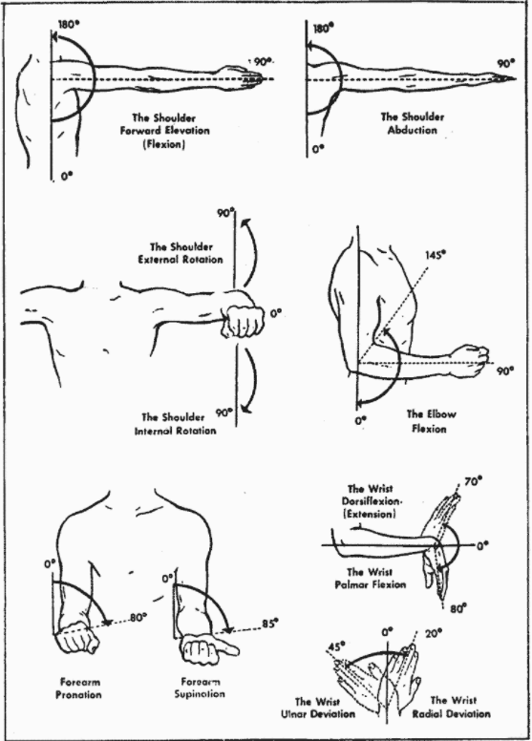
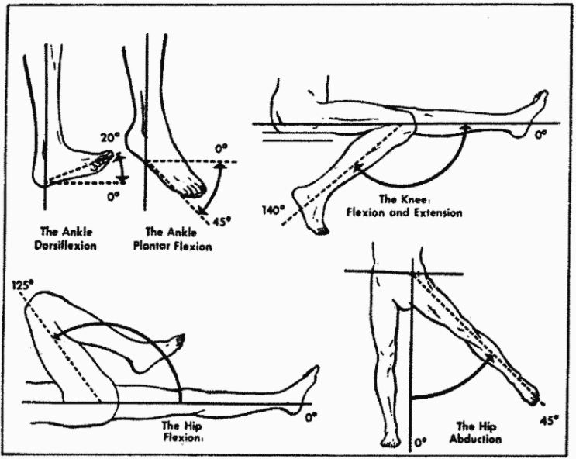
Normal Range of Motion: Plate I & II
Notes:
As you can see on plate II though, it shows the up and down flexion for a healthy ankle.

Slide 9
DC 5270:
Ankle, ankylosis of:
In plantar flextion at more than 40°, or in dorsiflexion at more than 10° or with abduction,
adduction, inversion or eversion deformity 40
In plantar flextion, between 30° and 40°, or in dorsiflextion, between 0° and 10° 30
In plantar flexion, less than 30° 20
Notes:
So on to the diagnosis codes. DX 5270 is the one with the highest rating for an ankle condition. So just note that the highest anyone can get for an ankle is 40%.

Slide 10
DC 5271
Ankle, limited motion of:
Marked (less than 5 degrees dosiflextion or less than 10 degrees plantar flextion) 20
Moderate (less than 15 degrees dorsiflextion or less than 30 degrees plantar flextion) 10
Notes:
Clarification was added in the recent update to the CFR

Slide 11
DC 5272
Subastragalar or tarsal joint, ankylosis of:
In poor weight-bearing position 20
In good weight-bearing position 10
Notes:
Subastragalar or tarsal joint is the joint between the calcaneus (heel) and the talus (bone right above it). Between calcaneus and fibula and tibia

Slide 12
DC 5273
OS calcis or astragalus, malunion of:
Marked deformity 20
Moderate deformity 10
Notes:
OS Calcis, is referring to the heel bone. Astragalus is also know as the talus, it is the tarsal bone in the foot. So this code is for when one of those two bones is damaged.

Slide 13
DC 5274
Astragalectomy 20
Notes:
Astragalectomy, sometimes called a talectomy, is a surgical operation for removal of the talus bone (astragalus) for stabilization of the ankle.

Slide 14
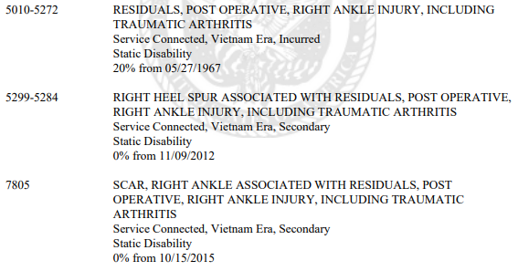
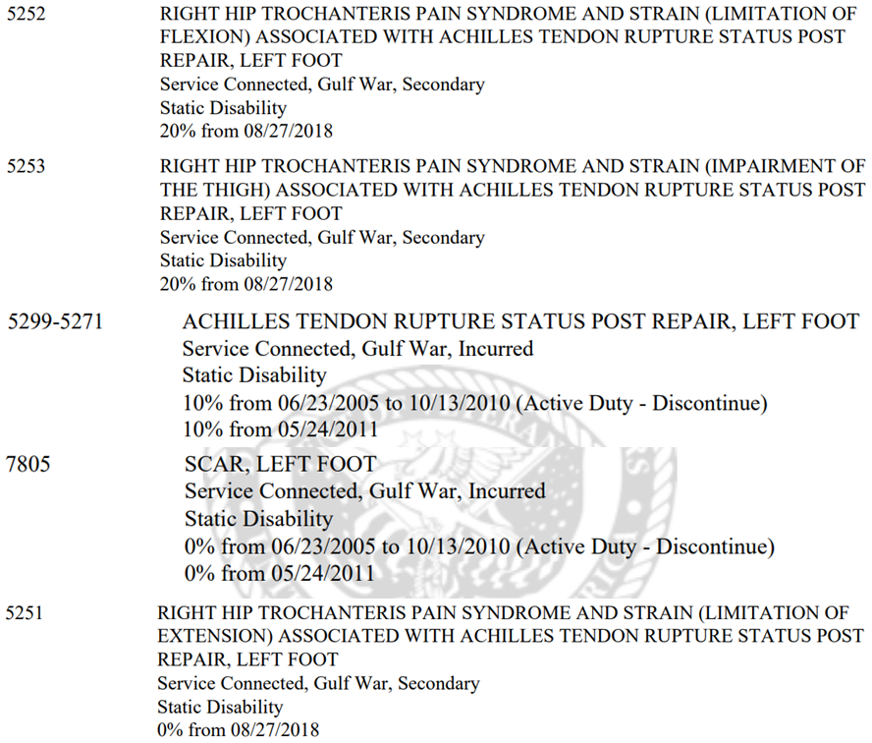
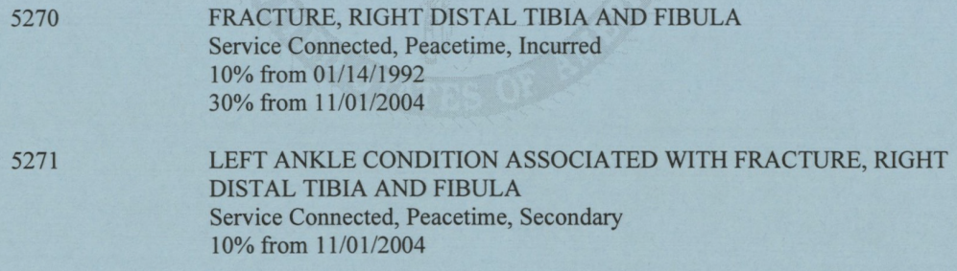
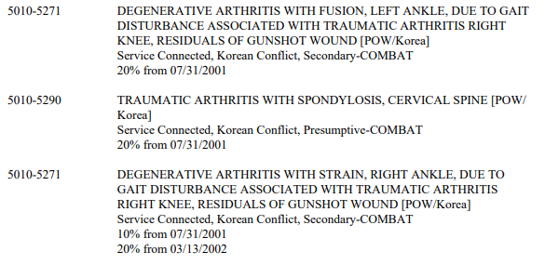
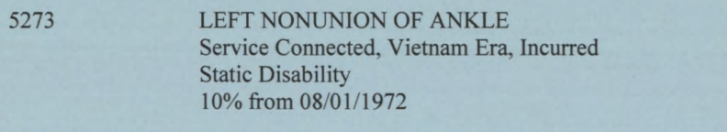
Examples:
Notes:
Look up Ron Spurlock 1305, he is currently working on getting a left ankle condition

Slide 15
Temp 100
Prestabalization § 4.28
Hospitalization for Treatment or Observation § 4.29
Convalescence § 4.30

Slide 16
Prestabalization § 4.28
They suffer from an unstabilized condition
That condition was incurred in service
The condition resulted in severe disability
That condition makes substantially gainful employment not feasible or advisable
This is meant for the immediate period following discharge from service and continue without reduction for a 12-month period after discharge
A re-evaluation will be scheduled by VA between 6-12 months
VA cannot reduce a prestabalization rating until after the 12months are up
Notes:
Some examples might be:
If you had a car accident in service and suffered a head injury, and have residuals from that head injury
If you were in combat during service and suffered gunshot wounds and now have residuals from those wounds

Slide 17
Hospitalization for Treatment or Observation § 4.29
A veteran can receive a temporary 100% rating for a service-connected disability that requires hospitalization for treatment or observation. The VA stipulation for this benefit is that the period of hospitalization must extend for 21 days or longer.
Date starts on admittance to hospital and ends on last day of the month following the termination of hospitalization.
If transferred to a private/community hospital due to lack of beds, will still count as long at the stay is still 21 days or more.
Both physical and mental ailments qualify.
Notes:
20 days or less gets squat, doesn’t matter that it’s close. The CFR gives specific examples of what does and does not work for authorized absences. More than 4 days immediately counts as being discharged. Multiple authorized absences of less than 4 days totaling more than 8 days will be counted as discharged starting on the 9th day.
Living in a nursing home, state veteran’s home, domiciliary, or transitional program does not count towards this. Unless they are in a hospital wing or their domiciliary is giving them treatment consistent with hospital care for a service connected disability.
Another note, if the veteran is admitted for a non-service connected reason but starts receiving care for a service connected benefit, and that care lasts 21 days or more, they can get the 100% rating starting the day that treatment for the scb started.
Temp 100 can be awarded if their stay is shorter than 21 days but will remain bed or house bound (or unable to work) and require frequent care from a home physician or nurse.

Slide 18
Convalescence § 4.30
Needs at least 1 month of convalescence
Surgery with severe postoperative residuals
Length of time is case-by-case. Extensions can be requested for more severe cases
Some conditions have automatic built-in periods of convalescence
  Example: After knee surgery four months are automatically granted.
Notes:
Surgery with severe postoperative residuals, such as:
Incompletely healed surgical wounds
Stumps of recent amputations
Therapeutic immobilization of one or more major joints
Application of a body cast
Necessity for home confinement
Necessity for continued use of wheelchair or crutches
A total rating under this section will require full justification on the rating sheet and may be extended as follows:
(1) Extensions of 1, 2 or 3 months beyond the initial 3 months may be made under paragraph (a) (1), (2) or (3) of this section.
(2) Extensions of 1 or more months up to 6 months beyond the initial 6 months period may be made under paragraph (a) (2) or (3) of this section upon approval of the Veterans Service Center Manager.

Slide 19
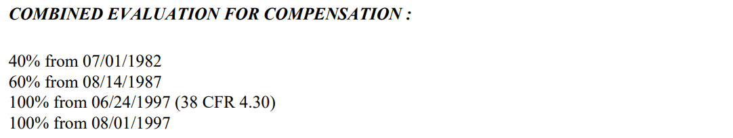
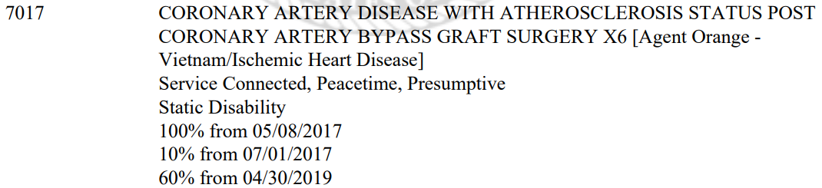
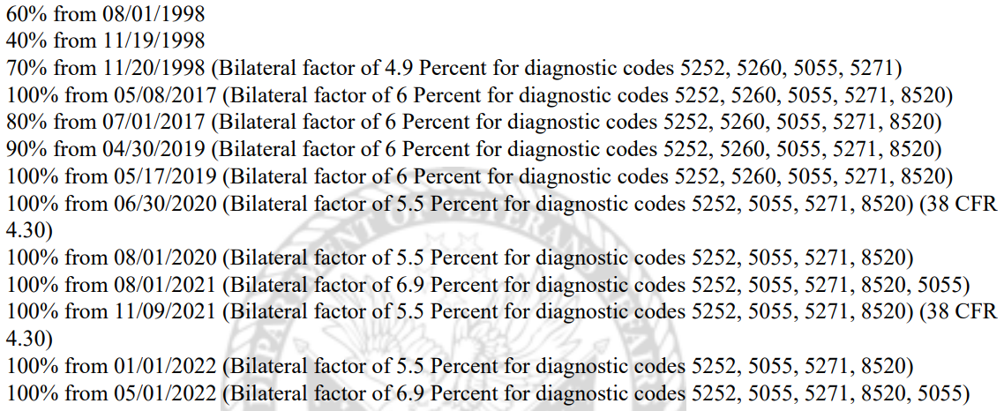
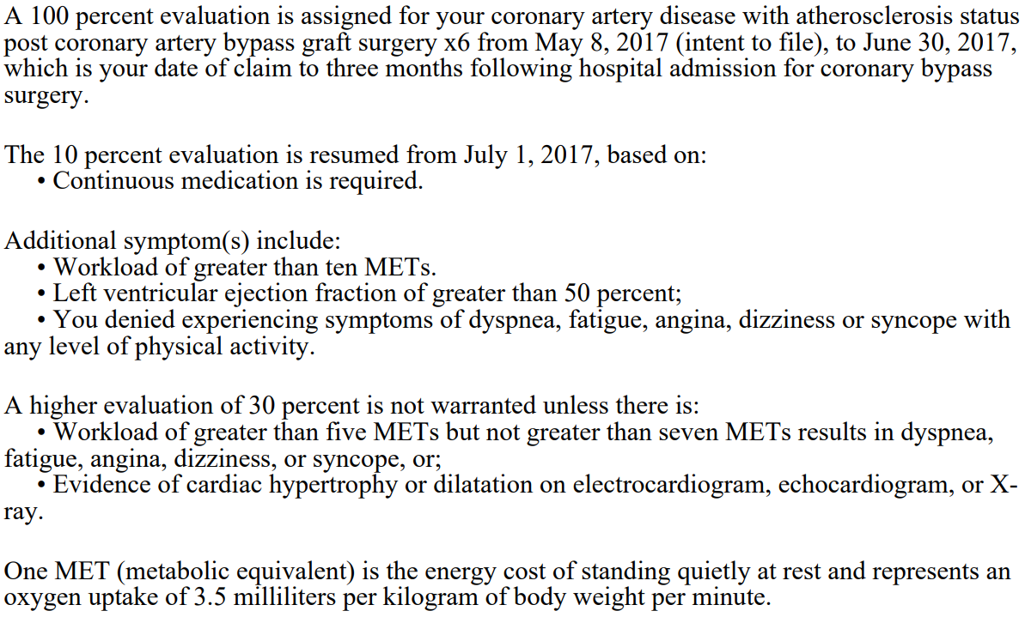
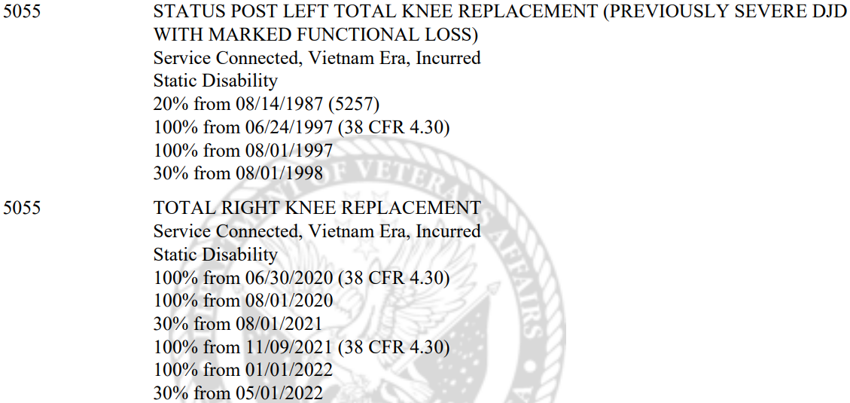
Notes:
This slide shows a veteran who has had several temp 100 because of repeated surgeries. I actually found this claim because he’s pending an extension of his most recent surgery. It also includes the dialog for one of the surgeries for why they granted 100% for only two months and then why they chose the 10% after that. This one was granted 2 years after the surgery happened, which is why they already knew what to do with him next.

Slide 20
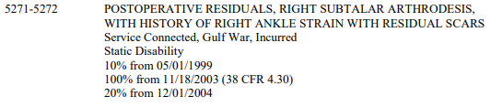

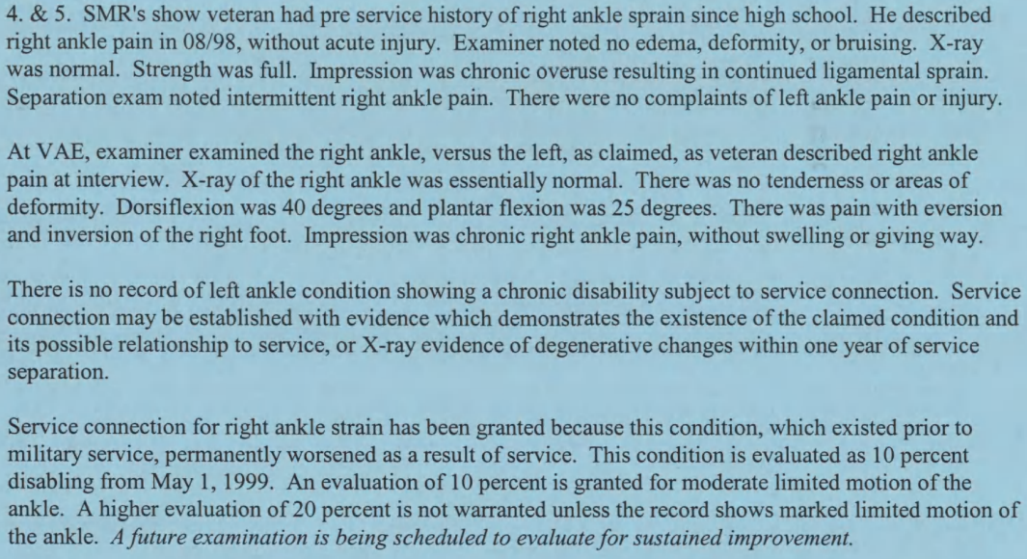
Notes:
This example is great for a couple reasons. First, he had pre-service history of ankle sprain. The last paragraph explains that they granted because it was shown that service permanently worsened his injury. Second, there are two places that talk about the left ankle not having recorded symptoms. The third paragraph explains what is needed to get the connection. Finally, the very last sentence tells that there will be a future examination. The code sheet I took this from is the most recent one, this narrative is from 1999 when they originally applied for the injury. You can see that they did to a re-evaluation and ended up doing surgery to prevent further degeneration. At that time, he was awarded 1 year of temp 100 before being re-evaluated to 20% and his disability is now listed as static.

